Slide 1

VIDEO TRANSLATION Using Deep Learning
Chirag Bellara
Rohit Ramkumar
Sai Suraj Matta Veera Venkata
Al Shafayet Haque Silvy

Slide 2

CONTENT
Introduction
Recap
New Work
Experience
Short Comings
Future Scope

Slide 3
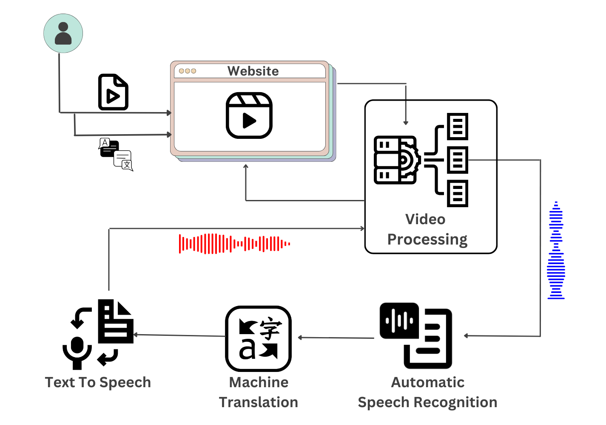
Introduction
Video or URL Input.
Video Processing.
Audio Extraction.
Speech Recognition.
Machine Translation.
Audio Generation.
Merging of New Audio and Video.

Slide 4
RECAP
Developed A Method To Extract Audio From A YouTube Link And Convert It Into Text.
Created And Tested Three Machine Translation Models, Including Google Translate, Azure AI Translator, And MyMemory, To Compare Accuracy And Speed.
Developed The Bark Model To Convert The Text Into Audio.
Created Code To Merge The Translated Audio With The Original Video For User Display.
Designed A Basic User Interface To Demonstrate The Progress.
Models Used:
OpenAI Whisper, Google Translate, Azure AI Translator, MyMemory, Bark by Suno

Slide 5
Work To-Be-Done After Mid Sem
Add An Option For Video Uploads.
Establish A Metric For Translation Accuracy.
Introduce Voice Cloning.
Explore Better Machine Translation And Audio Generation.
Seamlessly Integrate Advanced Models.
Ensure Smooth Audio-video Synchronization.
Minimize Video Processing Time.
Improve The User Interface.

Slide 6
New Work Done
Upload Video
Everything is faster!
Synchronization
UI
Better Models
Accuracy Metric
Voice Cloning

Slide 7
Experiences The Good and The Bad
Analysis of new model architectures and comparisons
Engineering methods to manipulate model outcomes
Writing and debugging better codes
Contributing in github

Slide 8
Experiences The Good and The Bad
Running out of GPU resources
Learning new web framework (Flask)
Difficulties in using new models

Slide 9
Shortcomings
Efficient evaluation of models
Workflows
Synchronization is not perfect.
Translation can be done to English only.
Collaboration with team members

Slide 10




Future Scope

Slide 11
Areas that can be Improved
Translation for videos with longer duration
Improve the efficiency of the application
Add transcripts for the translated language
Better audio and video synchronization

Slide 12
Possible Extensions
Use cases to be added in future
Multiple voices with voice cloning
Multiple languages
Accelerated conversion
Our own models with speech rate as a factor.
Clean UI with different language support
Feedback from users
Multiple conversion in same time
Several models to choose from

Slide 13
Thank You!
Questions?

